Slide 1
Refinitiv MarketPsych ESG Analytics
Real-Time, Quant-Friendly ESG

Slide 2
ESG Overview
Contradictions and Solutions
Notes:
The following slides will showcase 3 example uses of this ESG data for companies:
1. Portfolio formation
2. Finding winners
3. Risk Management

Slide 3

In 2020 Sustainability Turned a Corner Countries and Companies Announcing Mandates
Global ESG-data driven assets hit $40.5 trillion (Pensions & Investments, June 2020)
Deloitte forecasts that ESG-mandated assets could make up to half of all managed assets in the US alone by 2025.
Blackrock announced its $7 trillion in assets will be governed by ESG considerations.
China, UK, & California pledge to go carbon neutral.
Notes:
2:1 passive vs active
3:1 equity vs fixed income
iShares accounts for 3x the next largest (Calvert, then Vanguard)
Flows are estimated for 315 sustainable open-end and exchange-traded funds available to U.S. investors. The group includes equity, fixed-income, allocation, and alternatives funds that have an ESG, impact, or sustainable sector focus. Funds of funds are not included in this group.
3

Slide 4

A New Ethos Stakeholder Capitalism
Modern investors want capital to reward positive efforts:
Environmental impact
Social benefit
Governance integrity
This is “Stakeholder Capitalism.”
If investment flows are driven by these considerations, quants, advisors, brokerages, and corporations need to pay attention or lose clients and alpha.
Notes:
2:1 passive vs active
3:1 equity vs fixed income
iShares accounts for 3x the next largest (Calvert, then Vanguard)
Flows are estimated for 315 sustainable open-end and exchange-traded funds available to U.S. investors. The group includes equity, fixed-income, allocation, and alternatives funds that have an ESG, impact, or sustainable sector focus. Funds of funds are not included in this group.
4

Slide 5
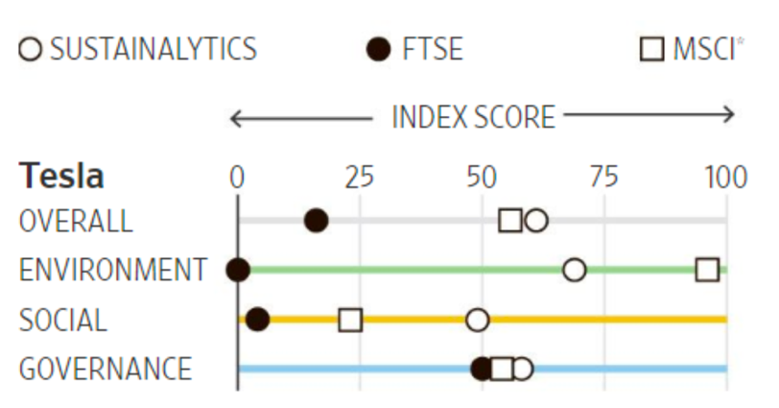
Is Tesla Unsustainable? ESG Data Consistency, Methodology, and Accountability Problems
Low Correlations
“correlation for the overall ESG and the environmental rating across providers is 0.46 and 0.43…more disagreement for the social and governance ratings, namely 0.33 and 0.19.” Source: Brandon, Kreuger, Riand, and Schmidt. 2020. “ESG Rating Disagreement and Stock Returns.” Swiss Finance Institute Research Paper No. 19-67.
ESG Rating Divergences
Methodology differences in weights, scope, and measurement
Source: Tracy Mayor. Aug 26, 2019. “Why ESG ratings vary so widely (and what you can do about it).” mitsloan.mit.edu.
Source: James Mackintosh. September 17, 2018. “Is Tesla or Exxon More Sustainable? It Depends Whom You Ask”. WSJ
Notes:
Rajna Gibson Brandon, ECGI, University of Geneva, Philipp Krueger, Geneva Finance Research Institute, Nadine Riand, Swiss Finance Institute, and Peter S. Schmidt, Geneva Finance Research Institute
Feifei Li, Ari Polychronopoulos. “What a Difference an ESG Ratings Provider Makes!” Research Affiliates. January 2020.
“In the United States, a portfolio selecting the top 50% of stocks with the highest social score based on Provider 1’s data produces excess returns that have a correlation of only 0.51 with the portfolio selecting the top 50% of stocks based on Provider 2’s social score.”
IDEAS MADE TO MATTER SUSTAINABILITY. Why ESG ratings vary so widely (and what you can do about it). Tracy Mayor Aug 26, 2019.
Scope divergence can occur when one agency includes greenhouse gas emissions, employee turnover, human rights, and corporate lobbying in its ratings scope, while another doesn’t consider lobbying.
Weight divergence can happen when agencies assign varying degrees of importance to attributes, valuing human rights more than lobbying, for example.
Measurement divergence occurs when ratings agencies measure the same attribute using different indicators. One might evaluate a firm’s labor practices on the basis of workforce turnover, while another counts the number of labor cases against the firm. While both capture aspects of a firm’s labor practices, they are likely to lead to different assessments, the research cautions.
All told, the research team was able to determine that differences in measurement explained 50.1% of total differences among ESG ratings, with divergence in weight explaining 13.2% of differences, and divergence in scope accountable for an average of 36.7% of differences. Taken together, weight and scope divergence can be seen as how a given rating agency defines sustainability.
5

Slide 6
Content Overview
ESG Analytics, Design, and Packaging
Notes:
The following slides will showcase 3 example uses of this ESG data for companies:
1. Portfolio formation
2. Finding winners
3. Risk Management

Slide 7

Social Media Calls Attention to Plastic Accumulated on a Bali Beach
ESG Controversy
Credit: @hiwayan for drone shot & @laurainwaterland⠀

Slide 8
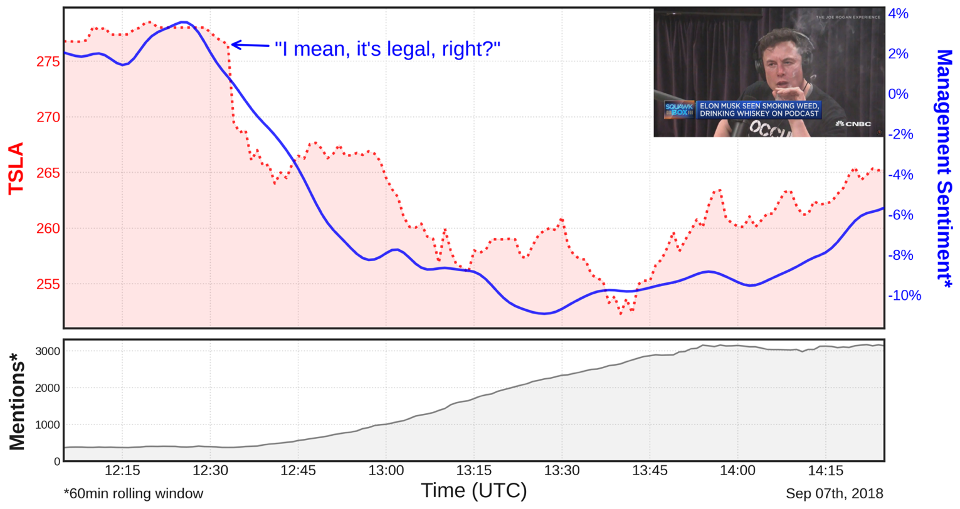
Elon Musk Smokes Marijuana on Joe Rogan Podcast
Controversial? - Sep 7, 2018
Notes:
Some ESG issues are sensational, but are they significant? What should we make of them?
Stock price reacts as if this is very significant. 2-years later TSLA stock us up 12x.
Which issues are significant to future corporate and country performance, and which are not?

Slide 9
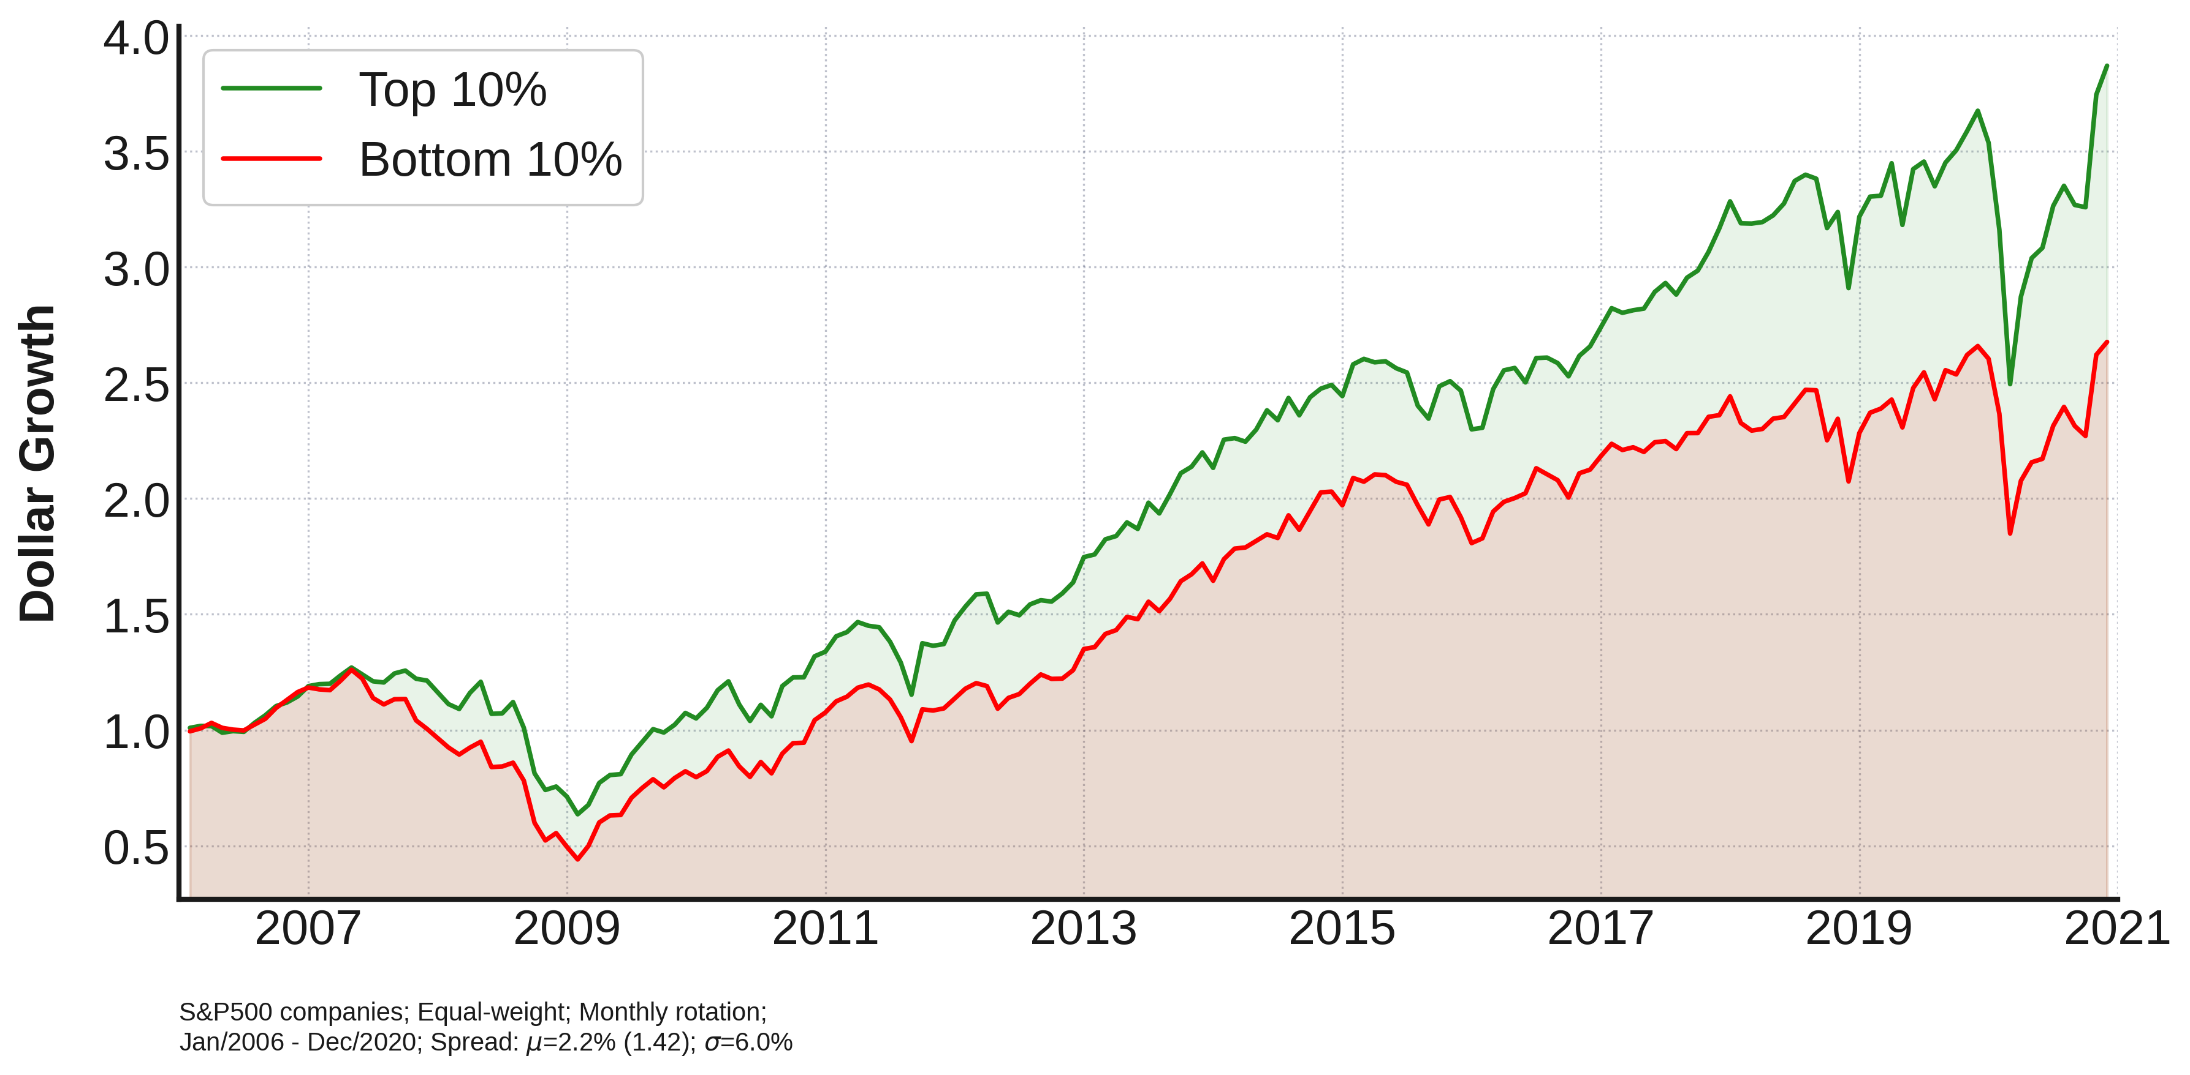
Does the Media Matter Long Term?
Investing in S&P 500 Stocks Based on Management Sentiment in the Media
Notes:
Companies with better perceived Management outperform their gloomier peers.
S&P 500 stocks were ranked by their average ManagementSentiment levels over the past month and binned into deciles. Performance of the top and bottom deciles was then tracked over the next month relative to the S&P 500. No transaction costs included. Rebalanced monthly.
Gompers et al (2003, QJE) “Governance Index” for 1500 firms in the 1990s.
>“Using the incidence of 24 governance rules, we construct a “Governance Index” to proxy for the level of shareholder rights at about 1500 large firms during the 1990s. An investment strategy that bought firms in the lowest decile of the index (strongest rights) and sold firms in the highest decile of the index (weakest rights) would have earned abnormal returns of 8.5 percent per year during the sample period. We find that firms with stronger shareholder rights had higher firm value, higher profits, higher sales growth, lower capital expenditures, and made fewer corporate acquisitions.“

Slide 10
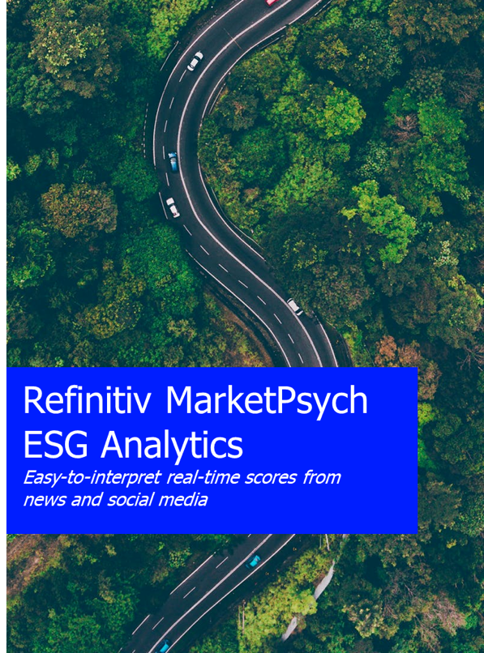
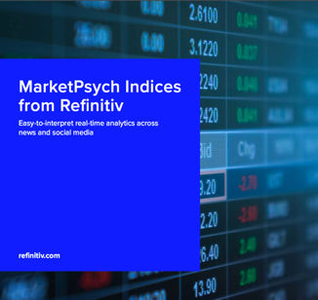



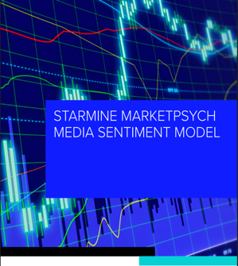

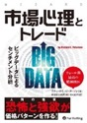

MarketPsych
Three Data Products
DATA
BOOKS
2007
2010
2016
Doing NLP media analysis since 2004.
Partnered with Reuters/Refinitiv 2011.
Data has over 55 academic papers with customers in 25+ countries.
Notes:
10

Slide 11
Refinitiv MarketPsych ESG Analytics
Wide coverage: 30,000+ companies and 250 geopolitical entities
Long history: 1998 to the present.
Multi-language: 12 languages.
External perspective: Detect greenwashing.
Point-in-time: Systematic company inclusion.
AI-based: Machine learning NLP system.
Highly granular: 100+ controversies and topics (Advanced only)
Real-time: 60-second, hourly, and daily updates (Advanced only)
News and Social Media Separate: Distinct News and Social (Advanced only)
Mappings: to Refinitiv ESG, the SASB framework, and U.N. Sustainable Development Goals (SDGs).

Slide 12

Nature of ESG Data
Refinitiv & MarketPsych
Company Reporting Based Rating
Media ESG Sentiment
Reporting company’s own view collected, interpreted and transformed into ESG Rating
Publicly available information, generated by the company + news controversies
Data based, rules based rating of companies performance.
1.
ESG 360∘ View
2.
Public’s perception of a company’s performance
Numerous news and social media sources
AI powered ”sentiment scoring”
Refinitiv-Inspired, MarketPsych-Powered
Key Differences | Refinitiv | MarketPsych
Source | Corporate Filings & RTRS News | 4000+ Prem. News & 2000+ Social Media
Data Collection | AI & Human Analysts | AI & NLP
Frequency of Updates | Weekly | Minutely
Point in Time | No (H2 2021) | Yes
Rating Methodology | Aligned Across All Pillars & Categories
Notes:
MarketPsych Analytics analyse news and social media in real time. They convert the volume and variety of professional news and social media into manageable information flows that drive sharper decisions. The Analytics are delivered as real-time data series that can easily be incorporated into analysis and decision processes – quantitative or qualitative.

Slide 13
Refinitiv MarketPsych ESG Analytics Two Data Packages: Core & Advanced
OVERVIEW
Delivered in Core & Advanced packages, Company & Country level scores available in both
Core updated daily / Advanced updated minutely
Mappings available to Refinitiv ESG with SASB framework considerations and U.N. SDGs
(1) CORE PACKAGE
Seventeen daily scores from combined news and social media for every company and country.
Buzz score (1)
ESG, ESG Conbined, ESG Controversies (3)
Pillar scores (3 = E,S,G), and
Category scores (10) provided.
Scores calculated as exponential weighted averages of media from the prior 365 days.
(2) ADVANCED PACKAGE Quant and Risk Manager-friendly
Provided with access to daily Core scores, plus:
111 scores for Companies published from news, news_headlines, social, news_social.
170 scores for Countries
Each Advanced score updates:
minutely (every 60-seconds),
hourly (24-hour rolling average), and
daily at 1530 U.S. Eastern Time.
Notes:
13

Slide 14
Natural Language Processing
Data Feeds Derived from Real-Time Media Analytics
Notes:
The following slides will showcase 3 example uses of this ESG data for companies:
1. Portfolio formation
2. Finding winners
3. Risk Management

Slide 15





Rating Structure
Refinitiv-inspired, MarketPsych-powered
Combining company reporting & controversies through a bottom-up ranking aggregation
ESG COMBINED SCORE
ESG Score
ESG Controversy Score
ENVIRONMENTAL
SOCIAL
GOVERNANCE
ESG CONTROVERSY
Resource use
Emissions
Innovation
Workforce
Human rights
Community
Product responsibility
Management
Shareholders
CSR strategy
Controversies across all 10 categories are aggregated in one category score.
CATEGORIES
252 SCORES PUBLISHED IN ADVANCED PACKAGE
From 4000+ ESG meanings, 252 ESG and Controversy scores delivered minutely, hourly, and daily in the Advanced Package
ESG METRICS
4000+ ESG-related meanings quantified in millions of media articles in real-time every day
Notes:
PLEase update as per your input data

Slide 16
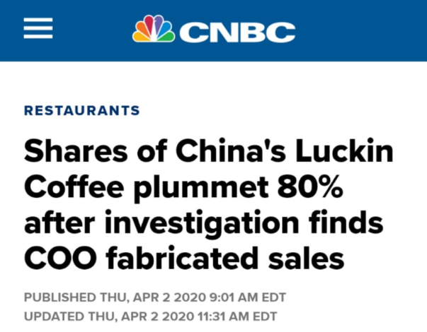
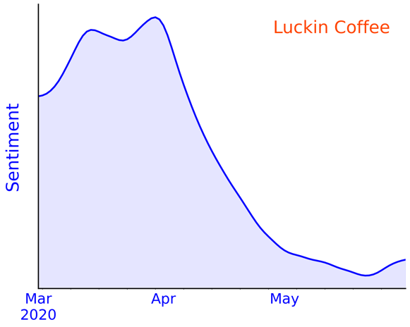
What We Do
Unstructured Data
Natural Language Processing
Structured Data
China
Luckin Coffee
Bearishness
Management Investigation

Slide 17
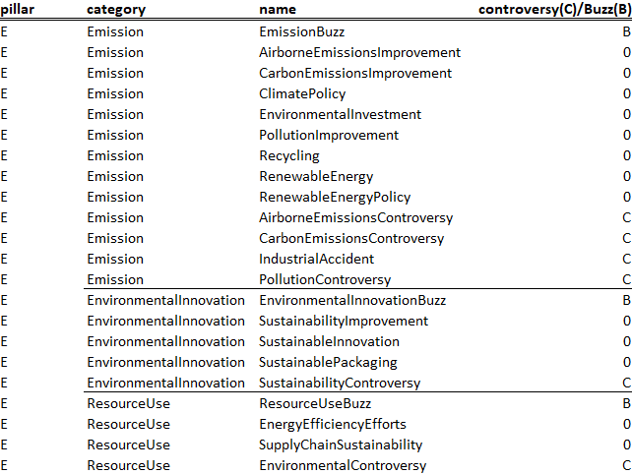
ESG Scores Are Hierarchical
Companies Environment Pillar
The thousands of detailed meaning scores are aggregated into Advanced scores (under “name” column) and summary Core scores.
Controversy scores constitute more than half of the Advanced scores, and they are designed to be unipolar for risk management and alerts.
Notes:
Note that Sovereign Assets is also called Country Markets and includes Bonds and Stock Index sentiments for 62 countries and the Eurozone.
Heres a looks into the indicators avaiible in each asset class . Know it s hard to see but iwatned to show you the breadth and debth
So you understand how this all fits togetyher lets pull out some indicators and how thehy could have helped in these situations

Slide 18
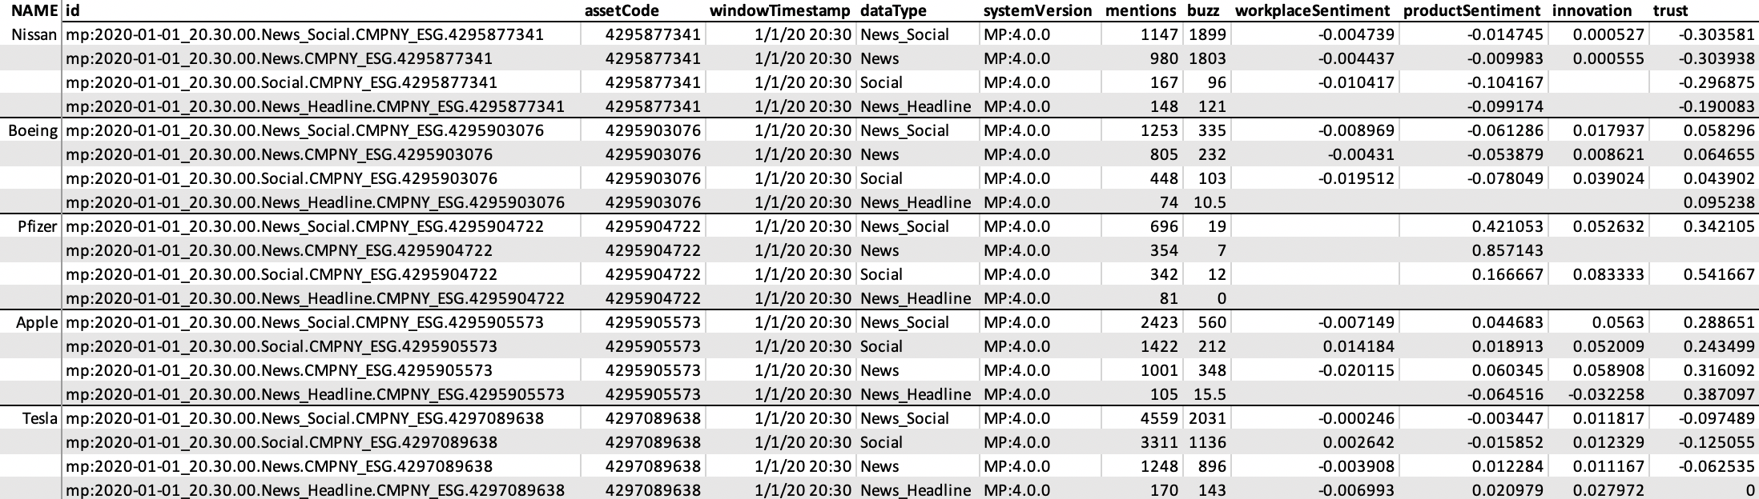
Sample Daily Output from Advanced Company-ESG Package
This is permID code for each company. Full mappings to CUSIIP, ISIN, SEDOL are available.
Separate data feeds delivered from news, social media, and news headlines. News_Social is an aggregate score.
The 80 company scores cover a variety of ESG themes and controversies.
Advanced ESG scores range from -1 → 1, while ESG controversy scores range from 0 → 1. The value is the percentage of all references to the company (buzz) containing this theme.
Note Boeing has low while Pfizer has high ProductSentiment. Nissan has low Trust.
Notes:
News that day reflected in the scores:
Investigation into Khashoggi disappearance at Saudi Arabian (SA) embassy in Turkey (TR)
US (US) threat to withdraw from the Intermediate-Range Nuclear Forces Treaty (INF) with Russia (RU)
US announces plans to cut Central American aid over migrant caravan

Slide 19
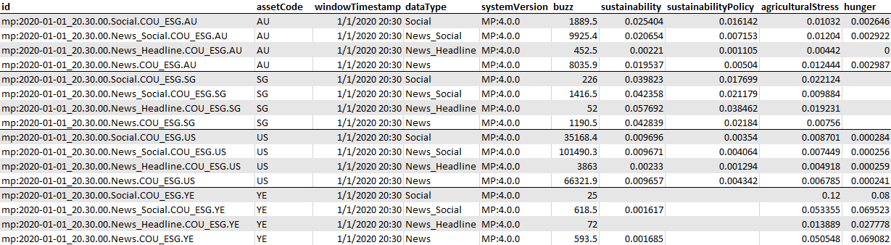
Sample Daily Output from Advanced Country-ESG Package
Separate data feeds delivered from news, social media, and news headlines. News_Social is an aggregate score.
This is the 2-digit ISO code (Reuters topic code) for each country.
The 152 country scores cover a variety of ESG themes and controversies.
SG
YE
Advanced ESG scores range from -1 → 1, while ESG controversy scores range from 0 → 1. The value is the percentage of all references to the country (buzz) containing this theme. No score is due to no media coverage of that theme.
Note Yemen has no sustainabilityPolicy references (YE) and relatively higher agriculturalStress and Hunger values. Singapore has no hunger references (SG).
Notes:
News that day reflected in the scores:
Investigation into Khashoggi disappearance at Saudi Arabian (SA) embassy in Turkey (TR)
US (US) threat to withdraw from the Intermediate-Range Nuclear Forces Treaty (INF) with Russia (RU)
US announces plans to cut Central American aid over migrant caravan

Slide 20
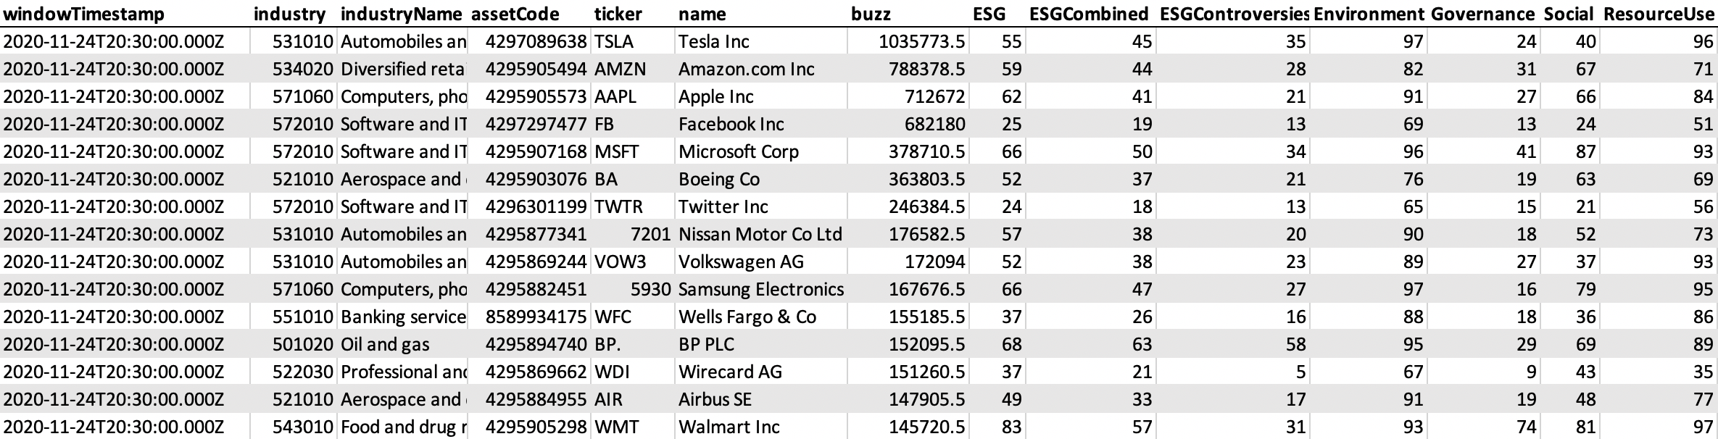
Sample Daily Output from Core Company-ESG Package
Industry TRBC code and name included.
The PermID for each Company.
The 3 ESG scores, 3 Pillar scores, and 10 Category scores extend off-screen.
Buzz is the number of ESG references in the past 365 days. All other Core ESG scores are 1 to 100 percentile ranks. Larger numbers are subjectively positive. Note that companies are percentile-ranked according to their Industry.
Note Wirecard has a low (5) Controversies score and low values are subjectively bad. Note BP has a high Environmental score (95) because companies are rated according to an Industry comparison (Oil), and BP has committed to go carbon-neutral.
Notes:
News that day reflected in the scores:
Investigation into Khashoggi disappearance at Saudi Arabian (SA) embassy in Turkey (TR)
US (US) threat to withdraw from the Intermediate-Range Nuclear Forces Treaty (INF) with Russia (RU)
US announces plans to cut Central American aid over migrant caravan

Slide 21
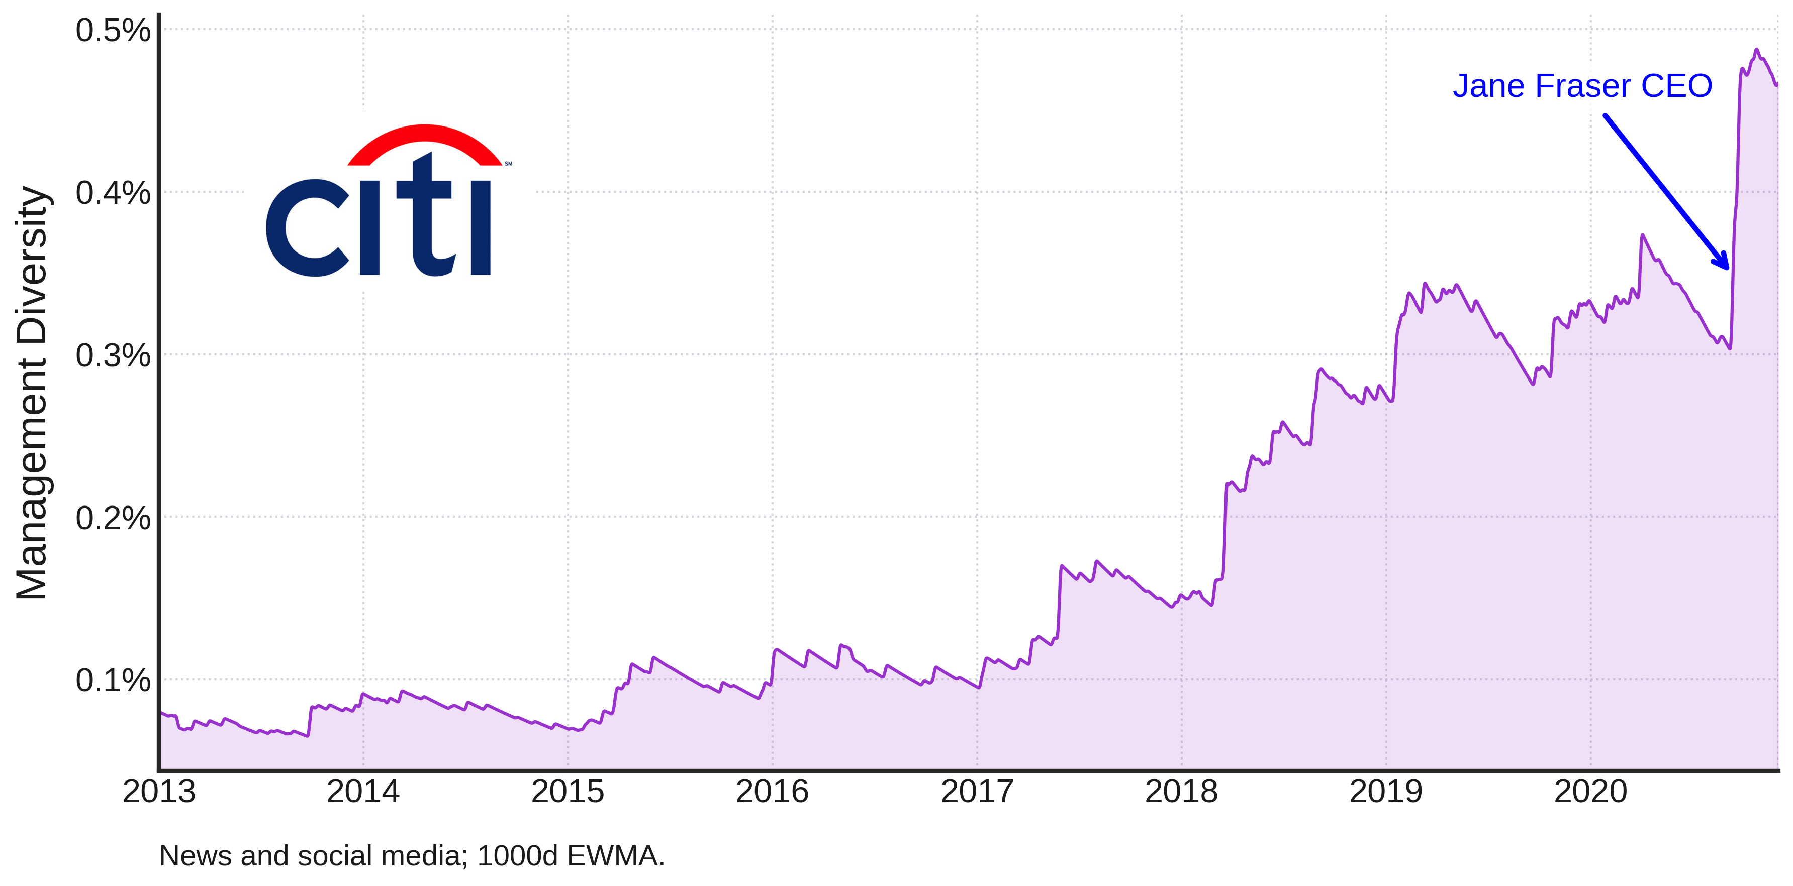
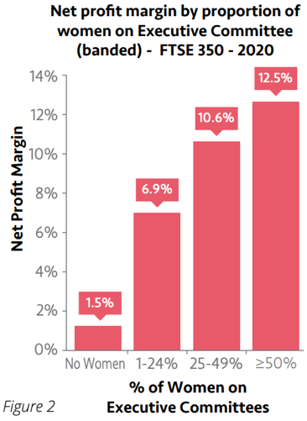
Media Reports on Management Diversity
Tracking the Management Diversity Index for Citi
Notes:
A study by Women Count found that “Companies with women in senior leadership roles are more profitable”.
The Management Diversity index for Citi has been rising over the years as the board becomes more inclusive (the bank’s board is nearly half women) and recently took a jump upon the announcement of Jane Fraser as new CEO in September of last year (she’ll be set on the position in February). Fraser will be the first woman to run a major investment bank.
Some scores, such as Management Diversity could be be directly compared to hard numbers. However, one should keep in mind that the actual value of a measure and how that is perceived may tell different stories, which is a point covered in further slides. Additionally, in this case specifically, Management Diversity also addresses general mentions to diversity and minorities in a management position, which can be more difficult to draft from the “hard” composition of the management.

Slide 22
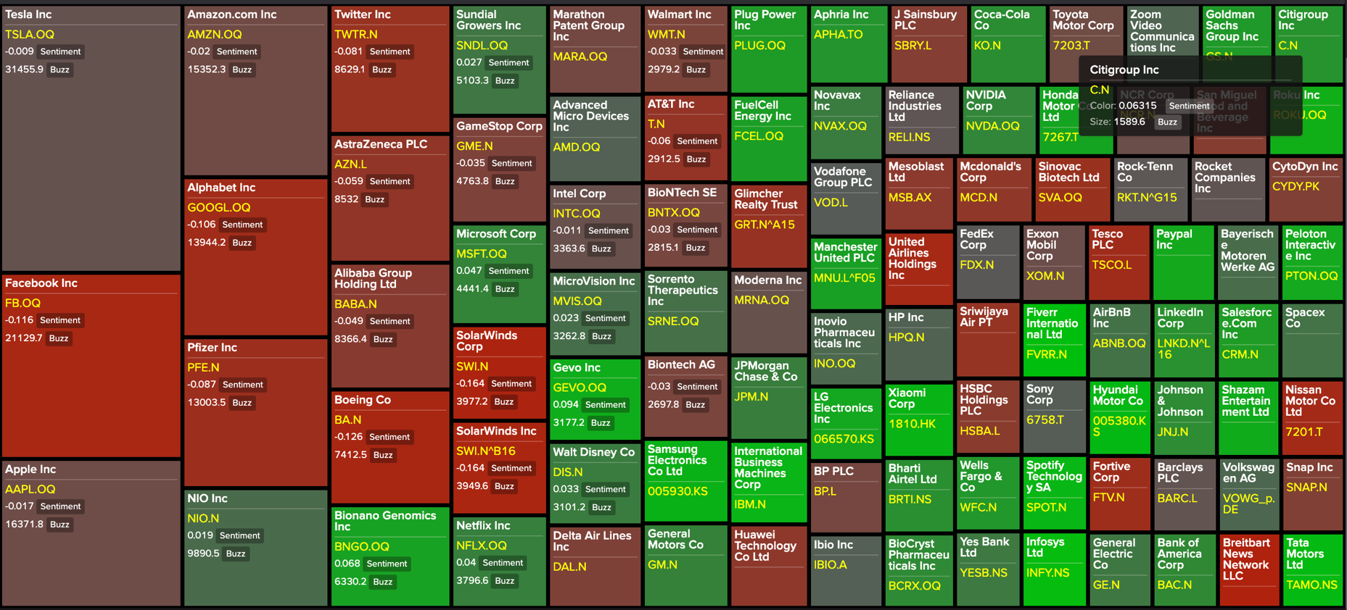
Citi Has Relatively High ManagementTrust in the Media
ManagementTrust Heatmap in MarketPsych Data Eikon App
ManagementTrust of Global stocks for Dec 2020 -Jan 2021, where green is more positive and red tones are more negative. Box size is Buzz.

Slide 23
Research Findings - Companies
Portfolio & Risk Management Case Studies
Notes:
The following slides will showcase 3 example uses of this ESG data for companies:
1. Portfolio formation
2. Finding winners
3. Risk Management

Slide 24
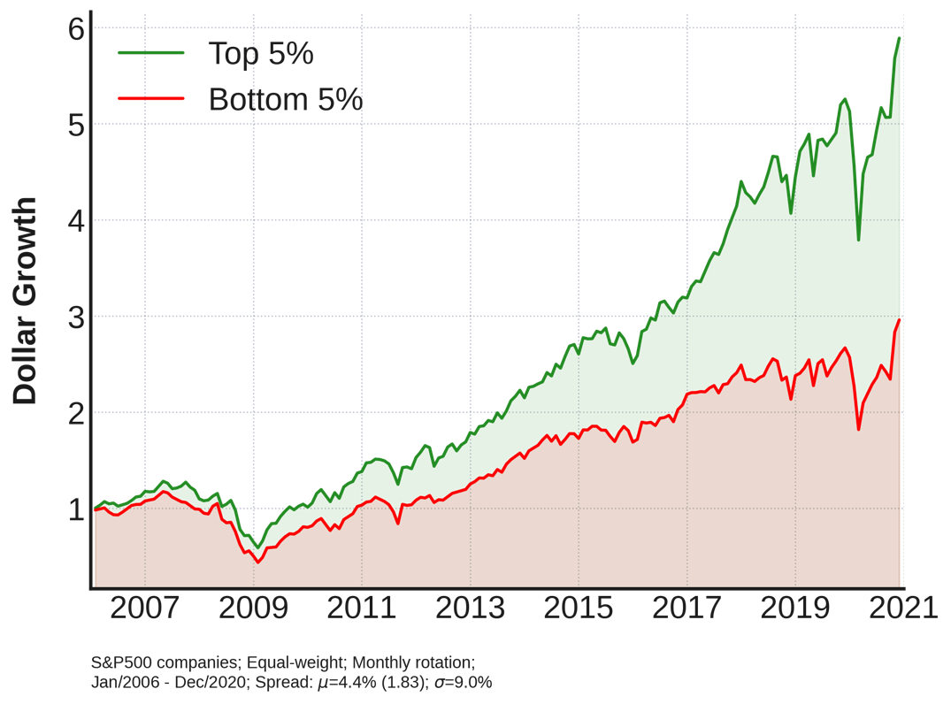
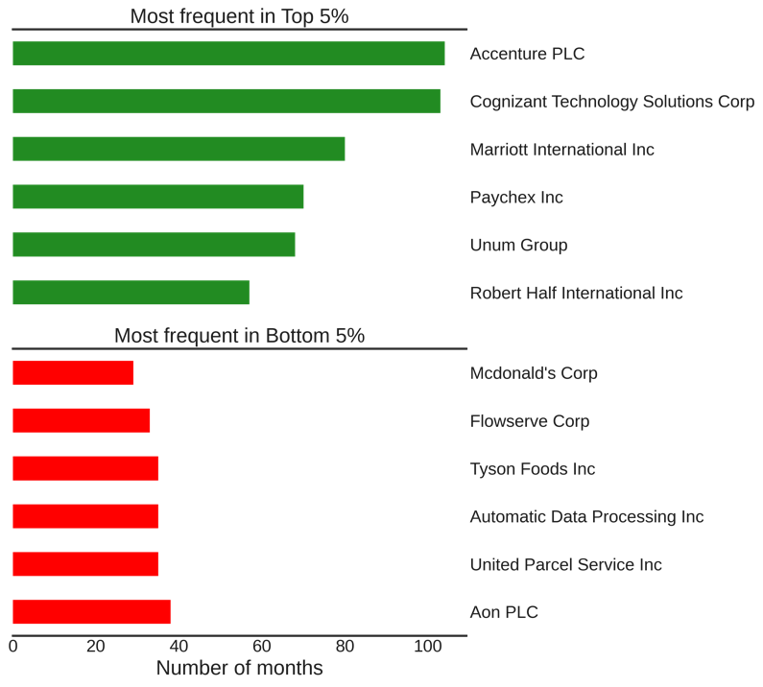
Use Case #1: Portfolio Formation
Investing based on the extremes of Workplace Sentiment
Notes:
Companies with better sentiment in the work place outperform (with a more pronounced effect in the tails)
S&P 500 stocks were ranked by their average workplaceSentiment levels over the past month and binned into quintiles. Performance of the top and bottom 5% was then tracked over the next month relative to the S&P 500.
No transaction costs included. Rebalanced monthly.

Slide 25
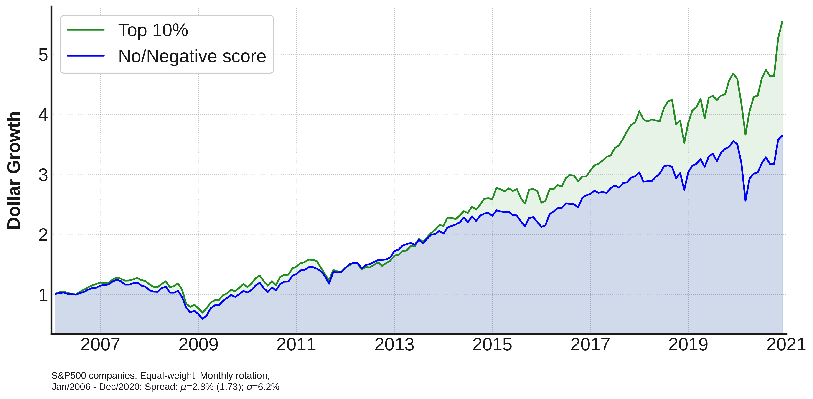
Use Case #2: Finding Winners
Investing in High Innovation Companies
Notes:
High innovation companies have outperformed since 2014.
S&P 500 stocks were ranked by their average Innovation levels over the past month and binned into deciles. Performance of the top decile was then tracked over the next month relative to the S&P 500
In recent years the decile of companies with the highest Innovation outperforms.
No transaction costs included. Rebalanced monthly.

Slide 26
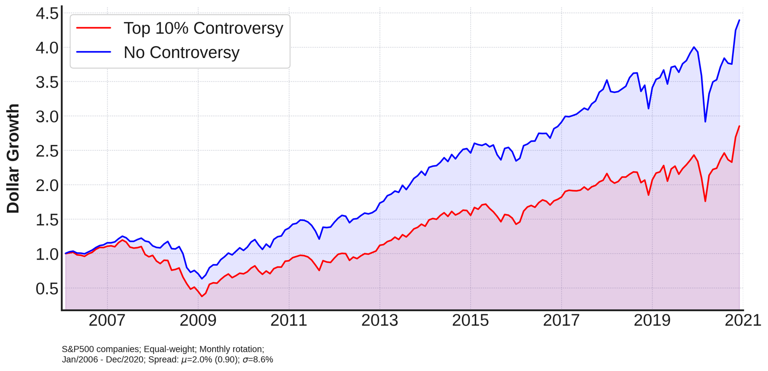
Use Case #3: Risk Management
Avoid Companies with Accounting Controversies…
Notes:
Over the long-term companies involved in accounting controversies seem to underperform the group of no-controversies stocks.
S&P 500 stocks were ranked by their average Accounting Controversies level over the past month and binned into deciles. Performance of the top decile was then tracked over the next month relative to the S&P 500.
The decile of companies with the highest Accounting Controversies underperforms.
No transaction costs included. Rebalanced monthly.

Slide 27
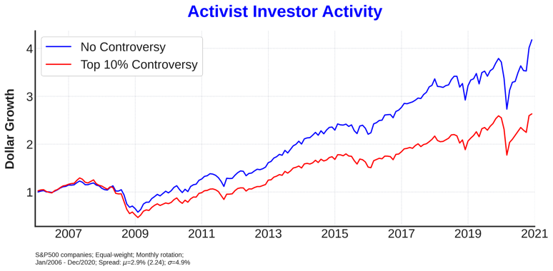
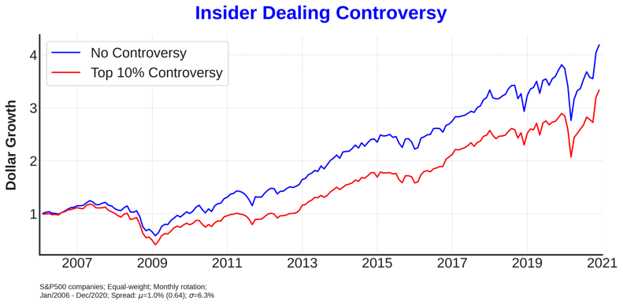
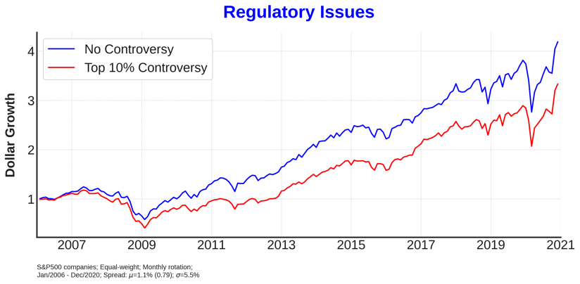
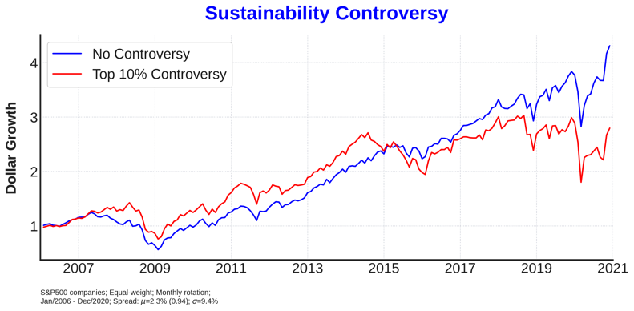
Use Case #3: Risk Management
…and also other Controversies
Notes:
Over the long-term companies with higher activist investor activity underperform.
Avoid companies with regulatory issues.
Avoid companies with insider dealing and selling.
Since 2014, companies high in sustainability controversy have been underperforming.
S&P 500 stocks were ranked by their average Controversy values over the past month. Performance of the top decile was then tracked over the next month relative to the S&P 500.
No transaction costs included. Rebalanced monthly.

Slide 28
Case Studies - Companies
Portfolio & Risk Management Case Studies
Notes:
The following slides will showcase 3 example uses of this ESG data for companies:
1. Portfolio formation
2. Finding winners
3. Risk Management

Slide 29
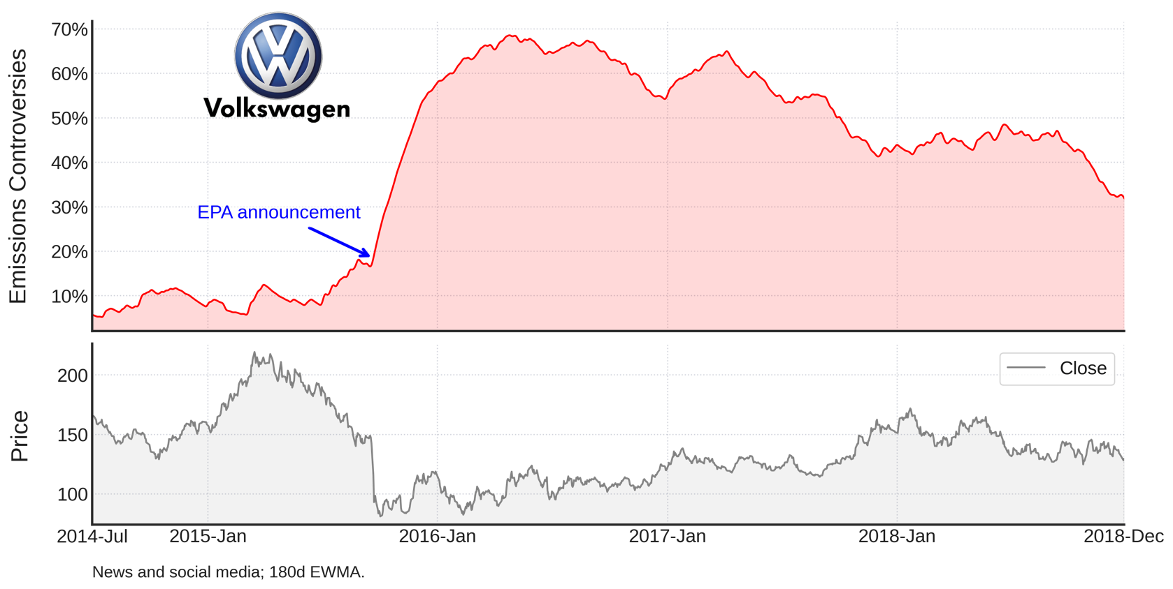
Use Case #3: Risk Management
Environmental: Emission Controversies
Notes:
Emission Controversies (Environmental pillar) exploded as the details of dieselgate were being released. Volkswagen stock only started its recovery after the media attention started moving away from the scandal (seen through the reduction in the index).
By using a real-time analysis of media information flow, our indexes quickly adapt to the current scenario. While metrics based on corporate filings can take even months to react to new information, the RMI-ESG scores are updated on a minutely basis on the lowest-latency feed.

Slide 30
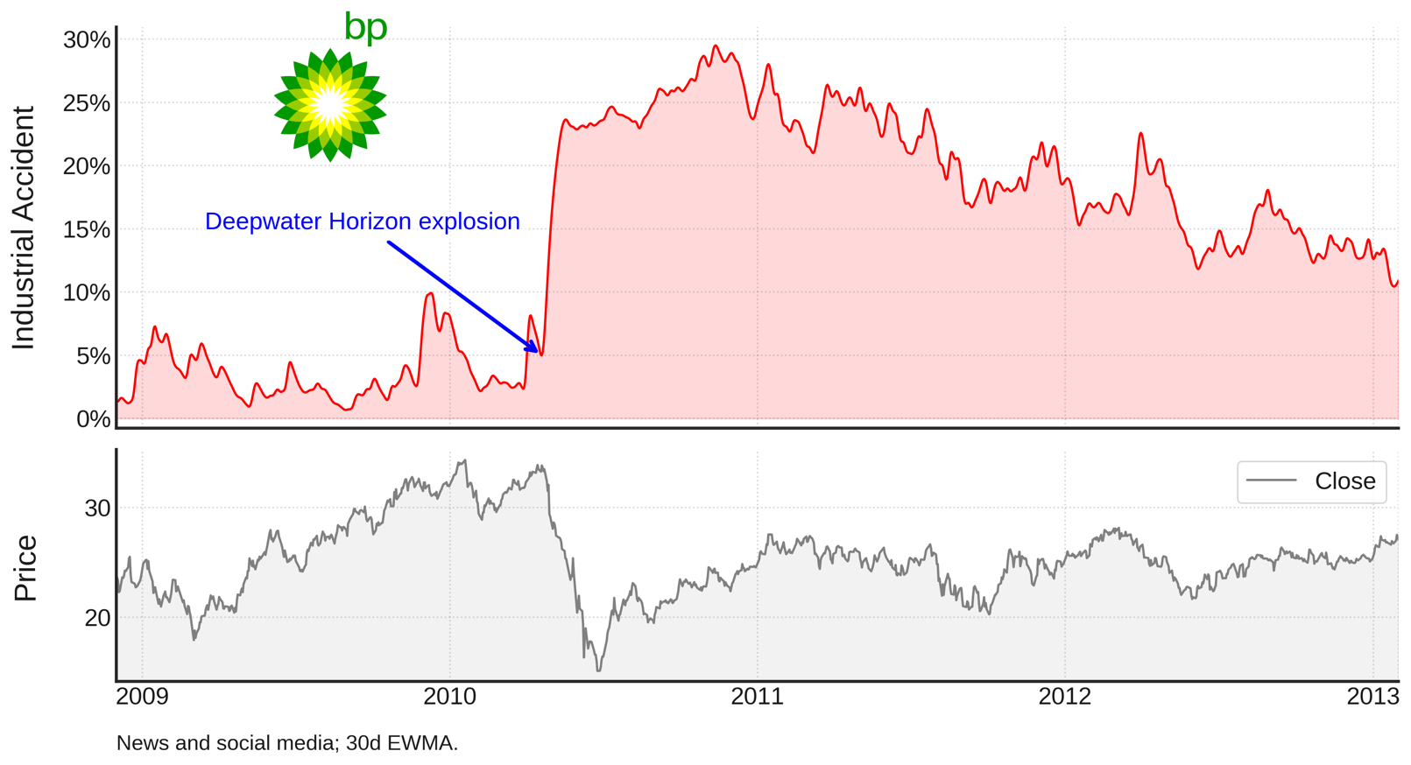
Use Case #3: Risk Management
Environmental: Industrial Accident
Notes:
Industrial Accident (Environmental pillar) around the Deepwater Horizon oil spill.
Yet another environmental case where the recovery in the stock only follows after the media buzz around the case plateaus.

Slide 31
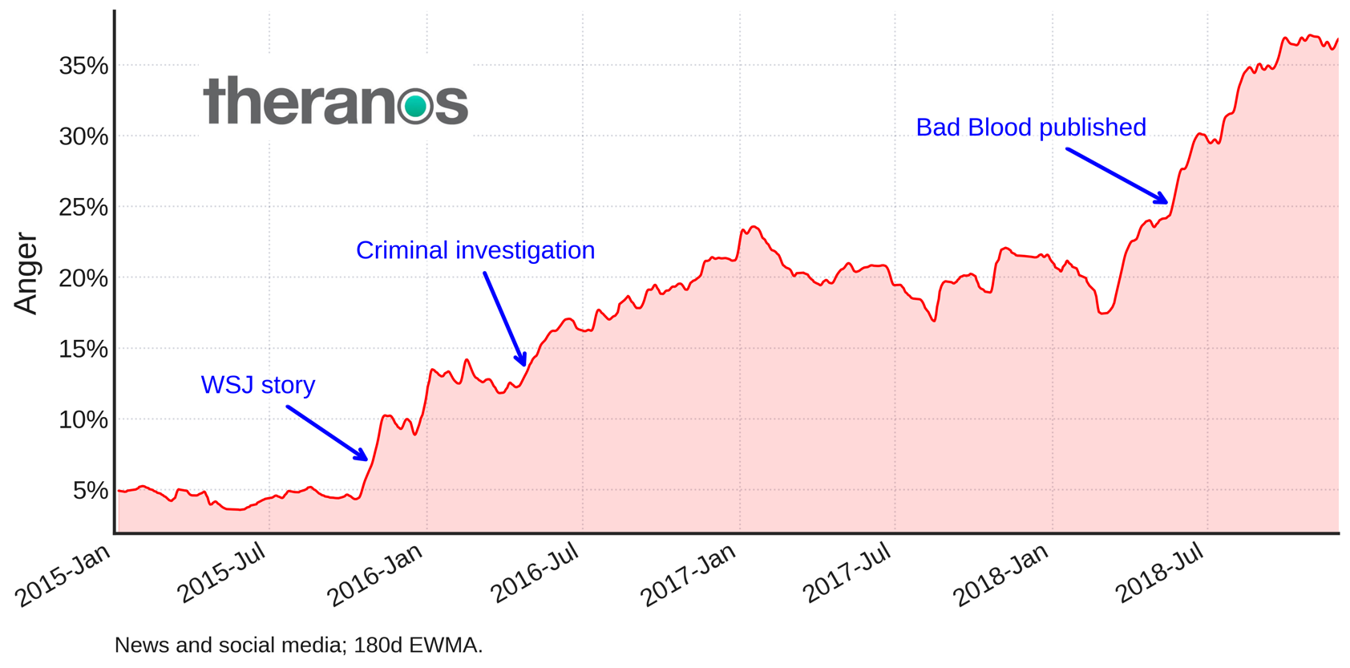
Use Case #3: Risk Management
Social: Anger
Notes:
The data allows quantifying the tone in the news and social media. Observe how the tone became increasingly angrier after John Carreyrou’s story was published in the Journal. This metric (included in the Social pillar) went even higher after the SEC charges and publication of the popular book Bad Blood by the same author.

Slide 32
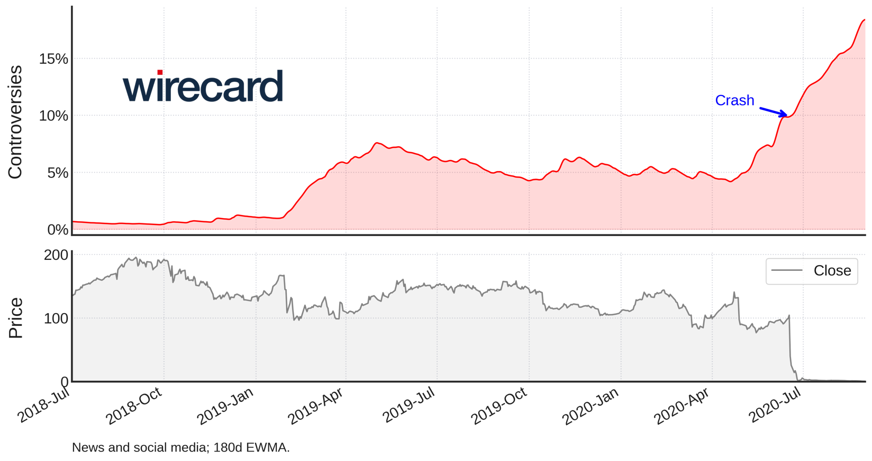
Use Case #3: Risk Management
Governance: Management & Shareholders Controversies
Notes:
Management and Shareholders Controversies (both under the Governance pillar) about Wirecard were on the rise since 2019

Slide 33
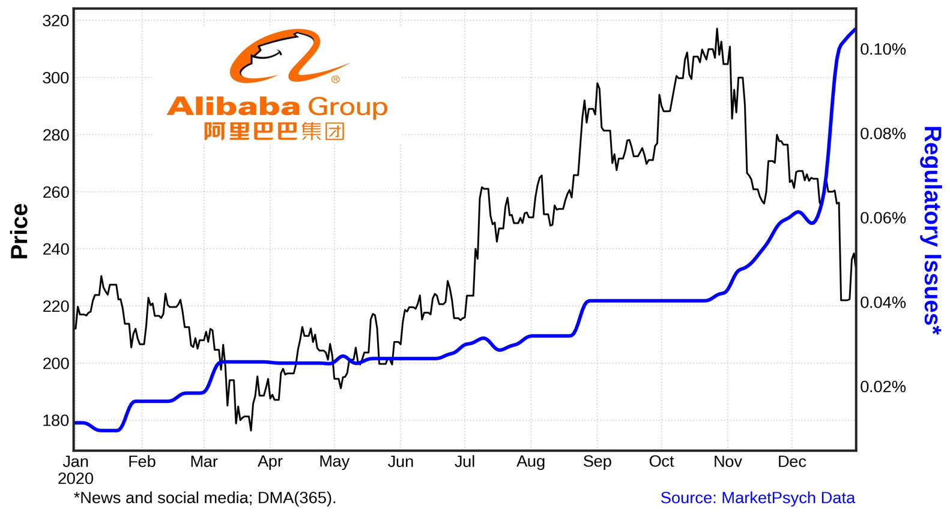
Use Case #3: Risk Management
Governance: Regulatory Issues
Notes:
Management and Shareholders Controversies (both under the Governance pillar) about Wirecard were on the rise since 2019

Slide 34
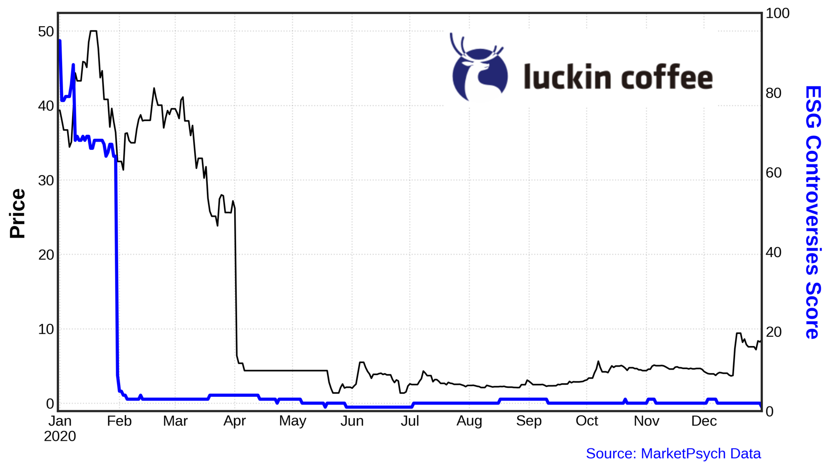
Use Case #3: Risk Management
Core Data: ESG Controversies
Notes:
Management and Shareholders Controversies (both under the Governance pillar) about Wirecard were on the rise since 2019

Slide 35
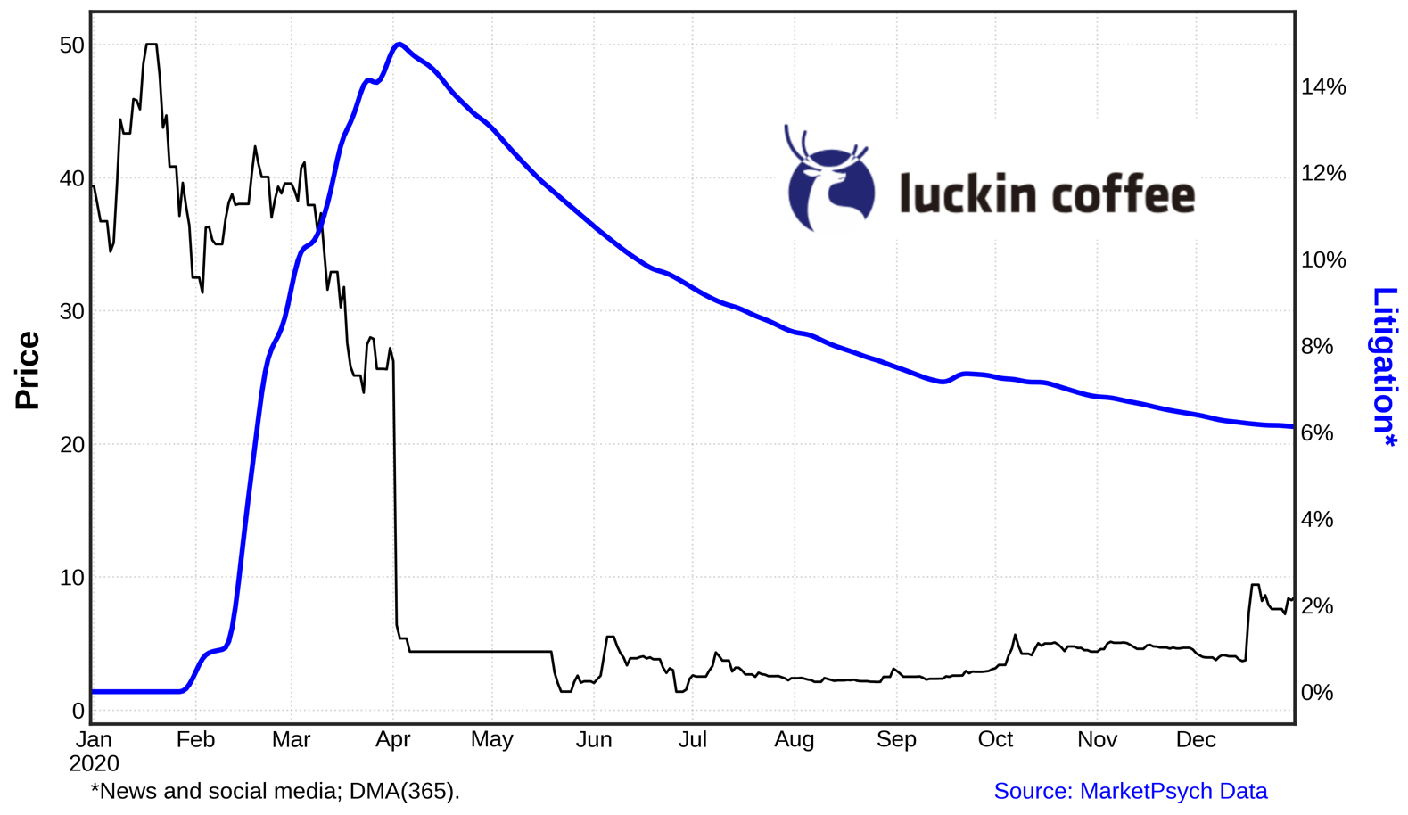
Use Case #3: Risk Management
Governance: Litigation
Notes:
Management and Shareholders Controversies (both under the Governance pillar) about Wirecard were on the rise since 2019

Slide 36
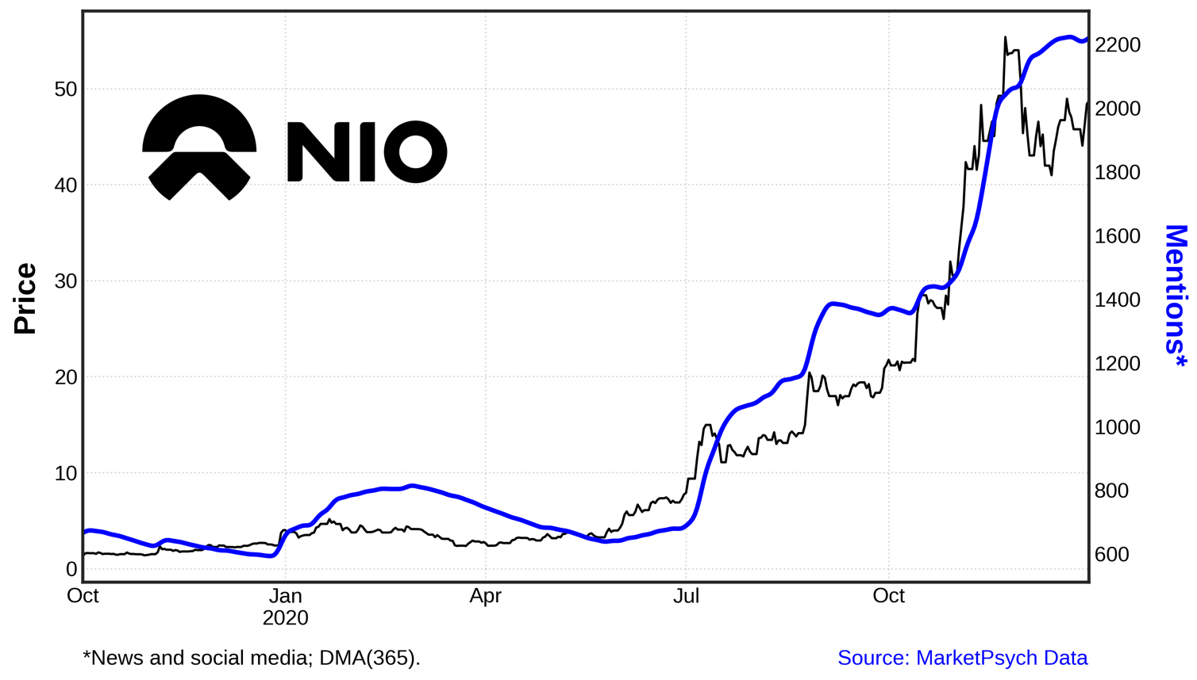
Use Case #3: Risk Management
Mentions: Social Media Irrational Exuberance
Notes:
Management and Shareholders Controversies (both under the Governance pillar) about Wirecard were on the rise since 2019

Slide 37
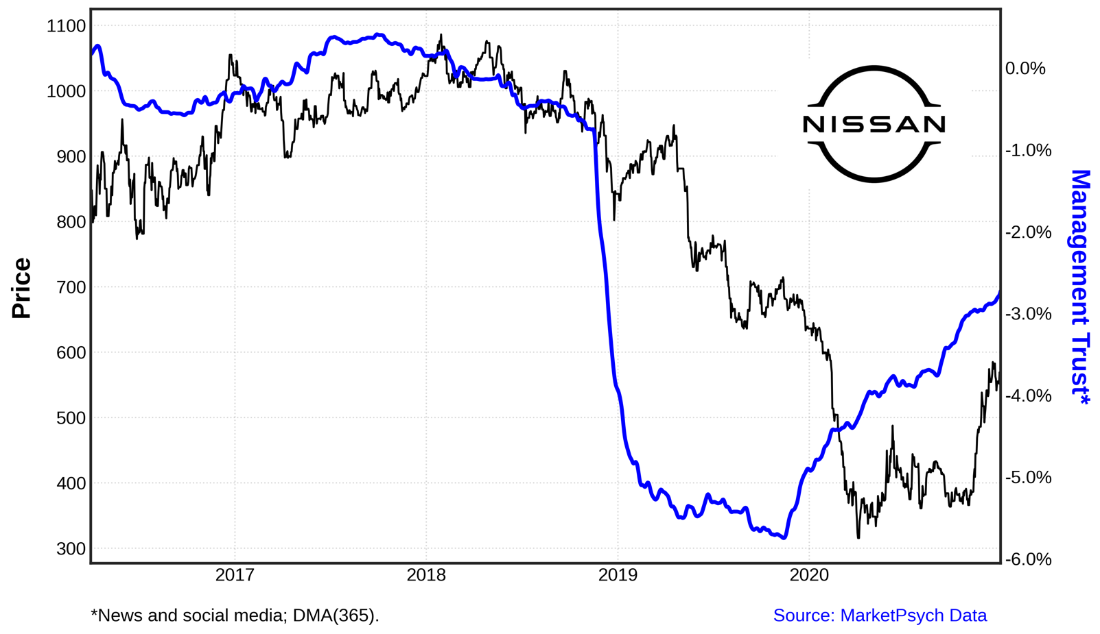
Use Case #3: Risk Management
Governance: Management Trust
Notes:
Management and Shareholders Controversies (both under the Governance pillar) about Wirecard were on the rise since 2019

Slide 38
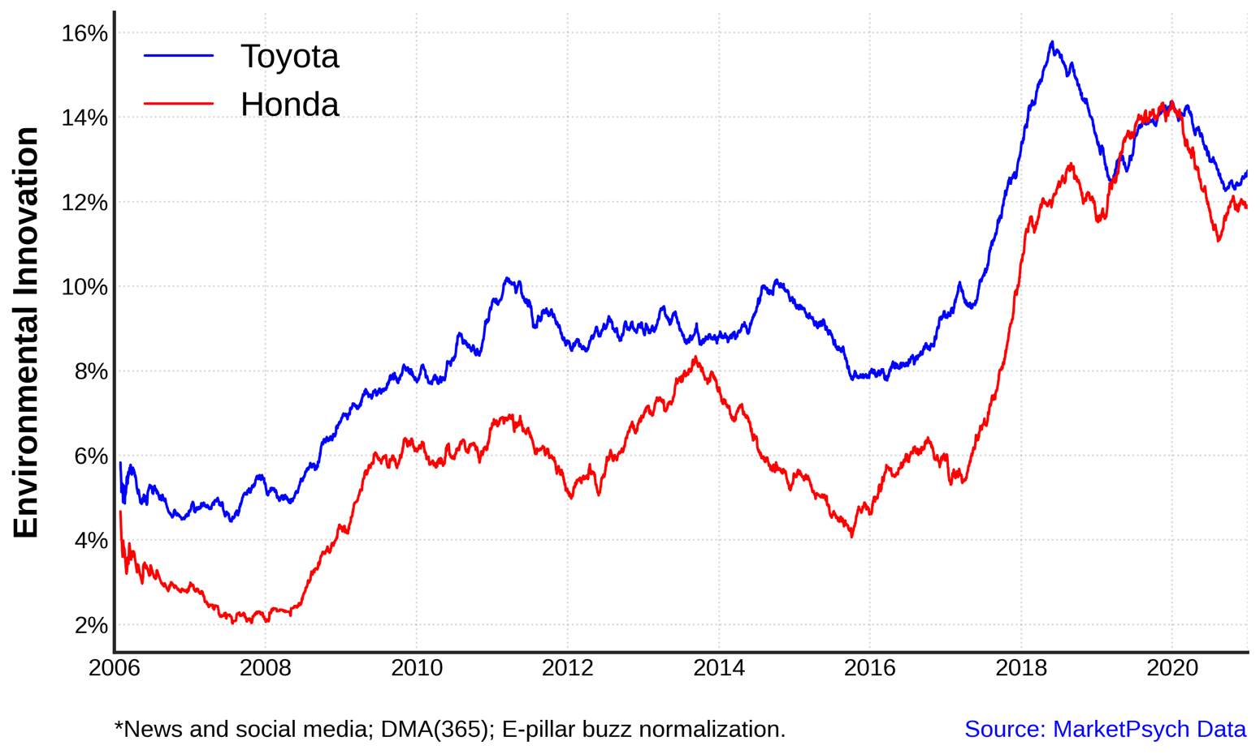
Use Case #2: Finding Winners
Environment: Environmental Innovation Growing
Notes:
Management and Shareholders Controversies (both under the Governance pillar) about Wirecard were on the rise since 2019

Slide 39
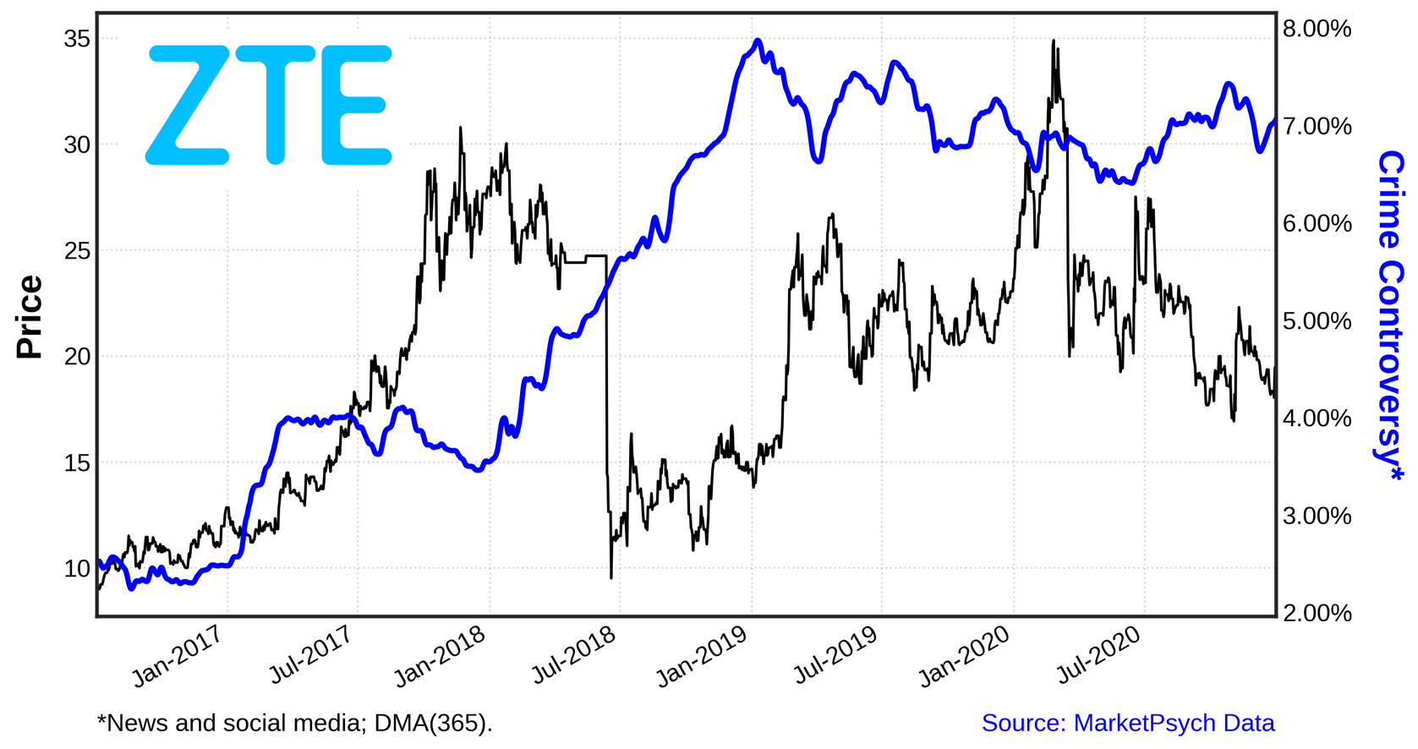
Use Case #3: Risk Management
Social: Crime Controversy
Notes:
Management and Shareholders Controversies (both under the Governance pillar) about Wirecard were on the rise since 2019

Slide 40
Research & Case Studies - Countries
Portfolio & Risk Management Case Studies

Slide 41
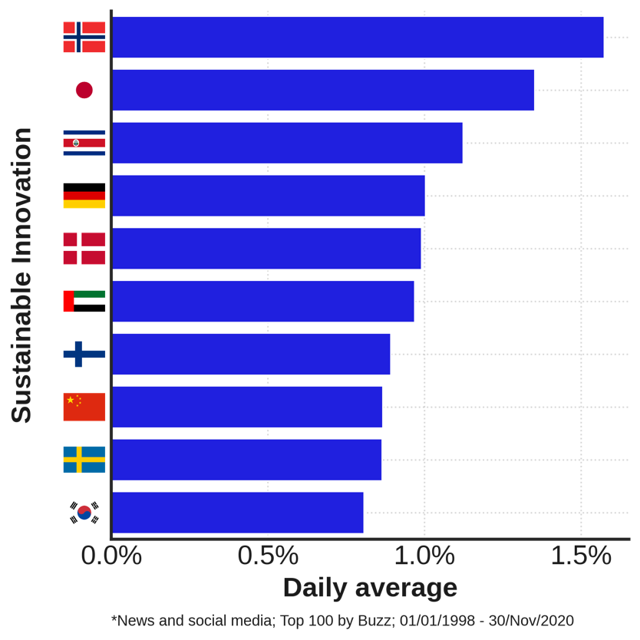
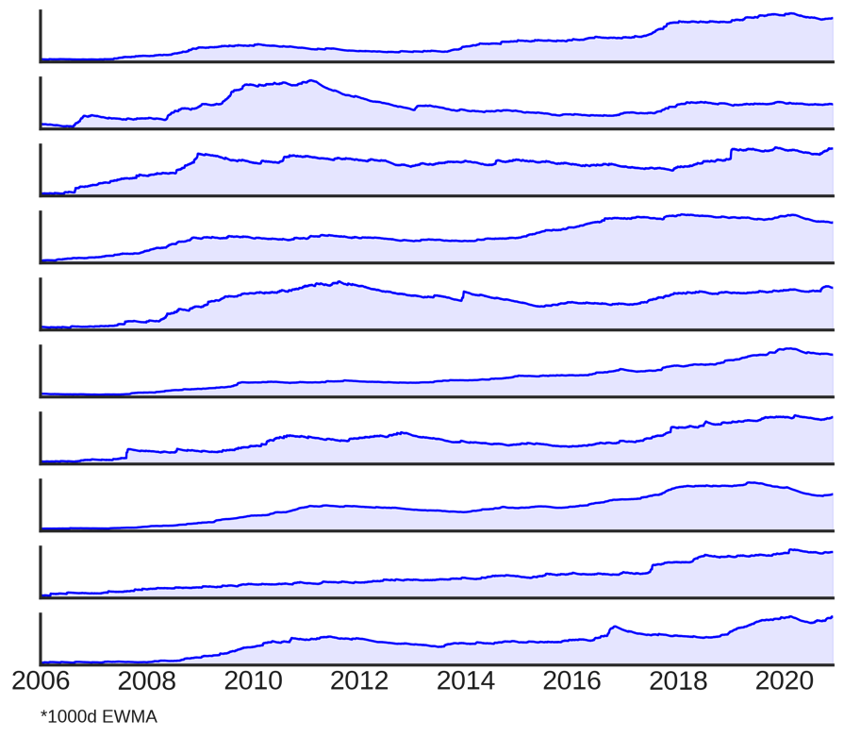
Use Case #4: Macro Investing (E)
Analyze Sustainable Innovation in Real Time
Notes:
The top 100 countries by buzz are ranked according to their daily average Sustainable Innovation score. The top 10 is shown in the left plot. Their respective time-series are shown on the right.
This index gives the media perception about how the countries are pursuing new technologies towards sustainability.

Slide 42
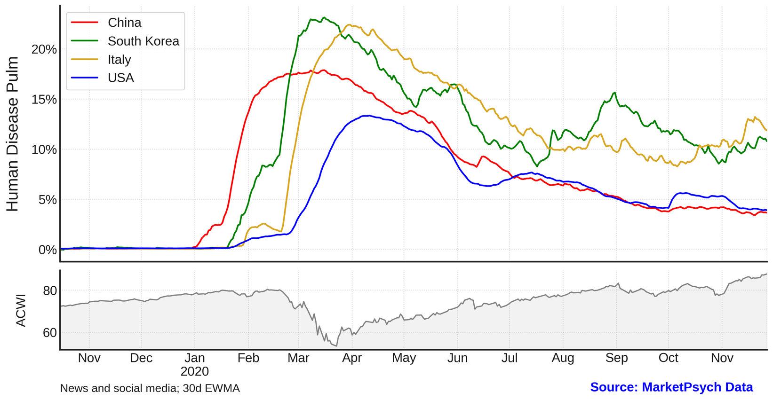
Use Case #4: Macro Investing (S)
Keep Track on the Information Flow about Epidemics
Notes:
A 30 days exponential moving average of the Disease Burden index is shown for 4 key countries in the early days of the Covid crisis. The ACWI ETF price is shown in the lower subplot.
This is yet another example of how the media perception gives a more dynamic picture than some hard numbers, such as number of new cases or hospitalizations. Despite a second (/third) wave hitting the US and Europe in the summer (in the Northern hemisphere) and late in the year, the buzz around the pandemic was actually smaller than at the beginning of the crisis. This is evidenced in the next slide.

Slide 43
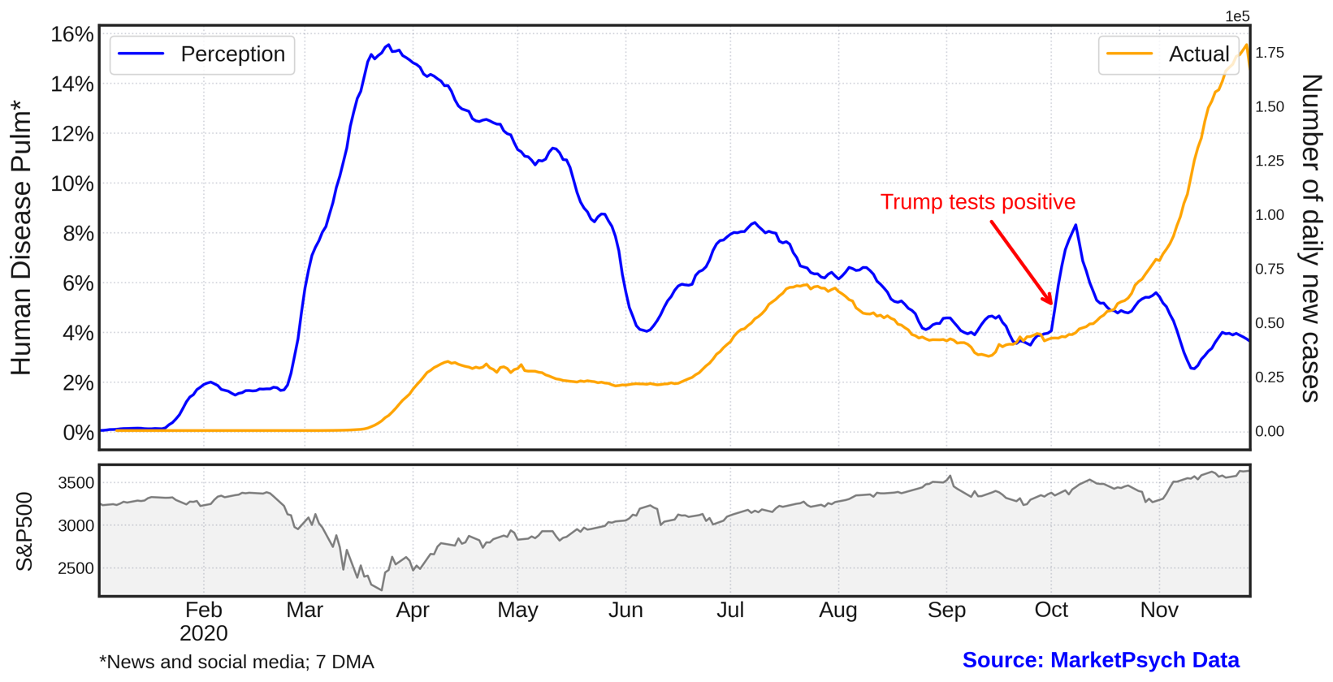
Use Case #4: Macro Investing (S)
Keep Track on the Information Flow about Epidemics

Slide 44
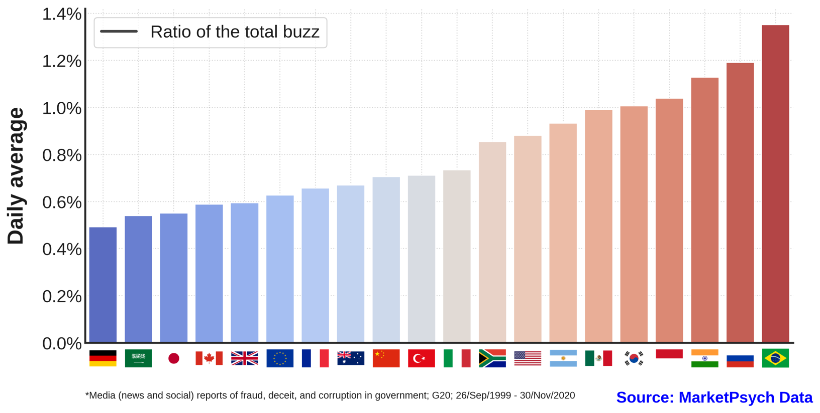
Use Case #4: Macro Investing (G)
Evaluate Government Corruption in Real Time
Notes:
The G20 countries are ranked according to the average daily value of Government Corruption. Political-related indexes such as this can be particularly important for evaluating risks of countries whose markets are heavily influenced by foreign investors perspectives.

Slide 45
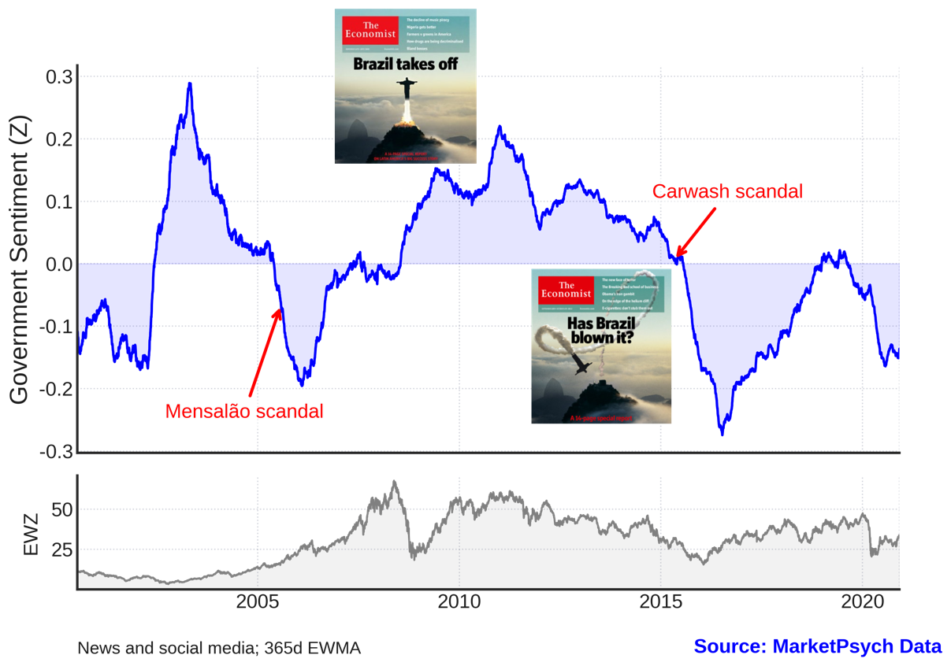
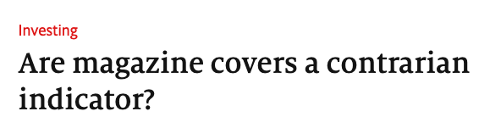
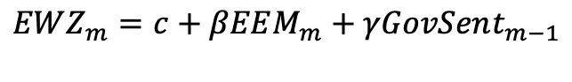
Use Case #4: Macro Investing (G)
Test Hypotheses about Government Sentiment
$$EWZ_{m}=c+βEEM_{m}+γGovSent_{m−1}$$
 | Coef. | t
c | 0.001 | 0.16
EEM | 1.300 | 22.12
GovSent | -0.047 | -2.05
N. Obs. | 210
R² | 0.705
Notes:
The ESG indicators can help with managing macro risks and also providing signs of overreaction. Emerging markets can be particularly sensitive on political developments in those countries. As the previous slide shows, Brazil has had the highest reporting of corruption among the G20 countries. The country has been plagued by several government scandals that severely affected its markets. Famously, in 2009, The Economist had the landmark Christ taking off in allusion to the countries economic bright future. That would mark the top of its equity market, which suffered from a perfect storm of crash of commodities and a large scale investigation on the countries largest state-owned company. Twelve years later and EWZ is still more than 30% off its value by the time of the publication. The timing of the cover (and some others) have inspired a Citigroup analysis using the cover of The Economist as a market mood indicator. Their analysis found that after 360 days only about 68.2% of Economist covers are contrarian. “Buying the asset if the cover is very bearish results in an 18% return over the following year; shorting the asset when the cover is bullish generates a return of 7.5%”
Inspired by that story we ran a simple linear regression on EWZ where we use the monthly average of the Government Sentiment feed and the EEM ETF monthly (adjusted) returns (m+1) as regressors while the EWZ (adjusted) returns at month (m + 1) are used as the dependent variable. The coefficients show that the Sentiment level is negatively correlated with the forward returns after accounting for the correlation with emerging markets as a whole. Hence, within these parameters, media sentiment about Brazil’s government has indeed been a contrarian indicator.

Slide 46
Summary of Findings
Using Media ESG Data in Active Investing
S&P 500 companies with good management outperform
(2.2% annually, top decile versus lowest)
Companies with happy, purpose-driven employees outperform
(4.4% annually at the extremes)
Innovative companies outperform
(2.8% annually, top 10% on Innovation)
Beware of high controversy companies
(Companies with Accounting controversies (top 10%) underperform 2.0% annually)
Media flow is faster than other ESG scores
Media flow allows us to unearth hidden gems and ESG laggards

Slide 47
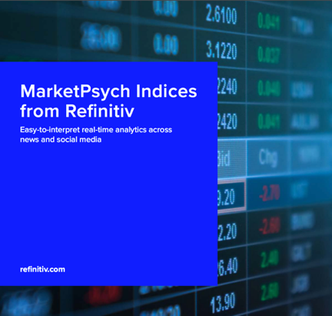

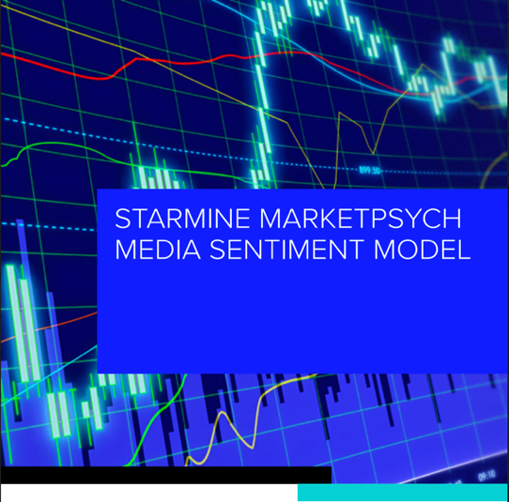
Q&A
Granular ESG scores are uncorrelated and uniquely contributory to alpha in quantitative investing.
Free trials of Refinitiv MarketPsych ESG are available.
MarketPsych provides 3 data products through Refinitiv:
Refinitiv MarketPsych ESG Analytics
StarMine MarketPsych Media Sentiment model
Refinitiv MarketPsych Analytics (a.k.a. Indices)
With over 55 academic papers and data customers in 25+ countries, MarketPsych data products are a market leader.
The data adds value in real-life – the predictive StarMine MarketPsych model is performing well since launch in Jan 2020.
Please reach out to your Refinitiv account manager or sales@marketpsychdata.com with any questions.
And please be careful out there! We wish you a healthy 2021.
Notes:
47

Slide 48
Thank you. Questions?

Slide 49

MarketPsych ESG Scores - Summary
Save Money on ESG Data: This dataset plus Refinitiv ESG data is complete ESG. \
Quant Relevant
Systematic, historical PIT data for accurate ML training and model testing.
Updated every minute (Advanced feed).
Delivered in an easy-to-research time series.
Preliminary quant research is available for review and appears promising.
Gain value where there is agreement and disagreement between the professional news and social media and other ESG feeds.
Identifier Mappings
Scores are mapped to Refinitiv ESG scores with Sustainability Accounting Standards Board (SASB) framework considerations. Country scores are mapped to U.N. Sustainable Development Goals (SDGs).
Companies are also mapped to identifiers including PermID, RIC, TRBC codes, SecID, Exchange, and Domicile. CUSIP, ISIN, and SEDOL mappings available with proof of client license.
The Data is Unique
AI-powered minutely ESG data for 30,000+ global companies and 250 countries and regions from thousands of credible media sources.
Uses a patented NLP process (Patent: US20130132071A1) to derive data from ESG-relevant articles.
Product Launch Mid-Feb 2021
Delivered over sftp. Datastream delivery planned in late Q3 2021.
Two packages: Core and Advanced

